Slide 1

CottonProphet Forecasting Future trends with AI
Using Artificial intelligence and Machine Learning to predict the price of cotton in future
Presented by:

Slide 2
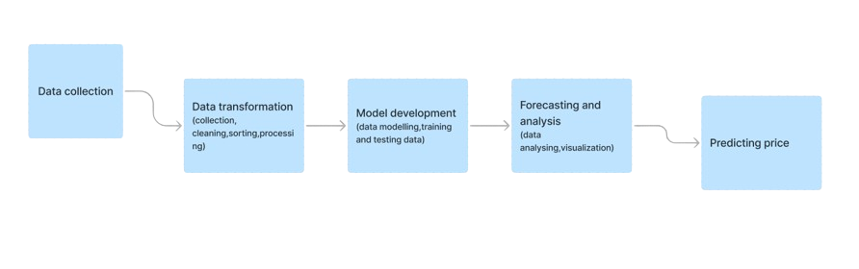
Calculating the probability of future market trend on the basis of past year data
Implementation of an AI and ML-based system that suggested an optimal pricing strategy for sales while utilizing past data to forecast future market trends for cotton...
Our target is to give the most accurate future prediction of cotton pricing, with the help of Artificial Intelligence and Machine Learning algorithms.
--Linear regression is a useful tool in predicting future cotton prices by establishing a relationship between historical price data and various factors influencing cotton prices.

Slide 3
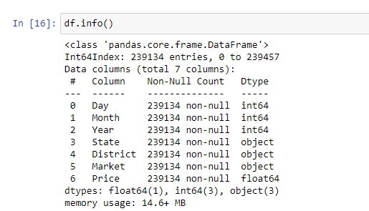
Dataset Details
The provided Data Frame has 239,458 entries and consists of 7 columns with the following information:
Day (int64)- Represents the day of the observation.
Month (int64)- Represents the month of the observation.
Year (int64)- Represents the year of the observation.
State (object)- Categorical variable representing the state information.
District (object)- Categorical variable representing the district information.
Market (object)- Categorical variable representing the market information.
Price (float64)- Numerical variable representing the price associated with the observation.
Dtype refers to the data type of each column (int64 for integers, float64 for floating-point numbers, and object for categorical or string data).

Slide 4
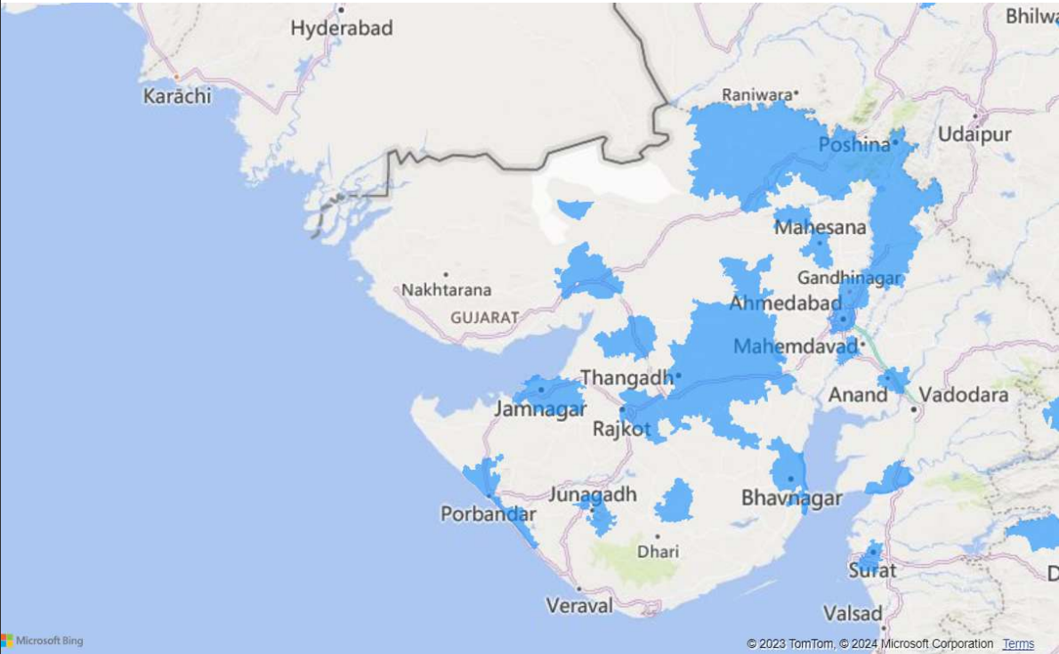
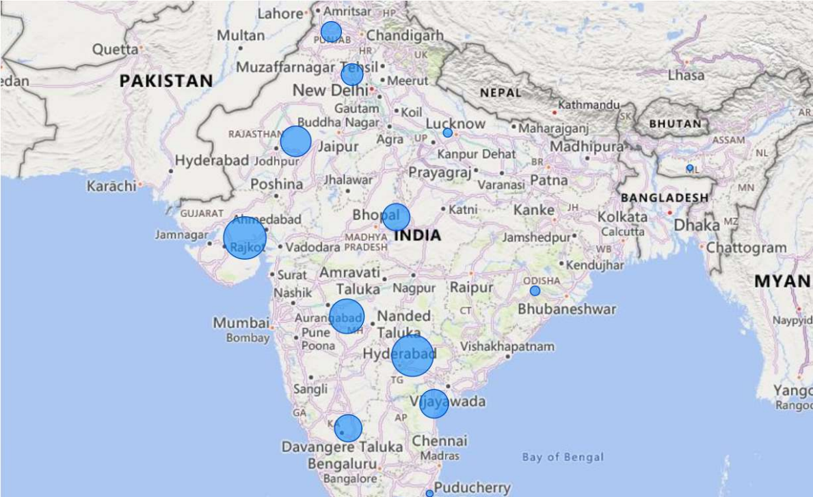
Indian cotton production distribution
India's cotton cultivation is concentrated in the cotton belt, encompassing states like Gujarat, Maharashtra, Telangana, Andhra Pradesh, Haryana, Punjab, Karnataka, and Madhya Pradesh. Gujarat is renowned for high-quality cotton, and other states also significantly contribute to India's cotton production. The distribution may vary annually based on factors like weather conditions and government policies.
Ahemdabad gained 3,28,625 Gujarat gained 22,47,41,237

Slide 5
Technology stack
Dependencies of this model
Data Cleaning and Pre-processing:
Pandas, NumPy
Data Storage:
Excel
Feature Engineering:
Scikit-Learn
Machine Learning Algorithms:
Regression Models
Decision Trees and Random Forests
Gradient Boosting Models
Dashboard and Visualization:
Matplotlib, Seaborn, Power BI
Data Availability
Machine Learning Frameworks and Libraries
Data Manipulation and Analysis Pandas
Machine Learning FrameworksScikit-learn
Time Series Analysis Prophet
Dependency Management Pip

Slide 6
Team Member Details:
Team leader name :
Mohammed Like (DS – 2nd Year)
Team member 1 name :
Rohit Karal (AIML – 2nd Year)
Team member 2 name :
Divyanshi (AIML – 2nd Year)
Team member 3 name :
Sakshi Choudhary (AIML – 2nd Year)

